Slide 1
Simple Interest
Year 11 Essentials

Slide 2

Learning Outcomes
Calculate Simple Interest (2.2.4)
(Application of percentages)

Slide 3
Up – Talk – Down
Spend 60 seconds writing down things you would save money for, or take a loan out for
When asked, everyone will stand up, take turns to say one of your items, and then sit down once you have had your turn to speak
Notes:
Have a general discussion with the class about things to take loans for e.g. car, holiday, eventually a house
How these could all start as things to save for car, holiday, house etc.

Slide 4

24
7
30
Simple Interest
Date: / /2018
EQ – How do I calculate Simple Interest?
When you deposit money into a bank, the bank pays you interest.
When you borrow money from a bank, you pay interest to the bank.
Simple interest is money paid only on the principal.
Rate of interest is the percent charged or earned as a decimal
I = P $×$ r $×$ t
Time that the money is borrowed or invested (in years).
Principal is the amount of money borrowed or invested.

Slide 5

24
7
30
Simple Interest
Date: 30/8/2018
EQ – How do I calculate Simple Interest?
Words Associated with Simple Interest
Per annum: It is Latin for per year. Per annum can also be written as p/a or p.a.
Investment: An amount of money put aside to earn money
Loan: Borrowing money from the bank and paying that amount of money back plus interest
Licensed under CC BY-NC-ND

Slide 6
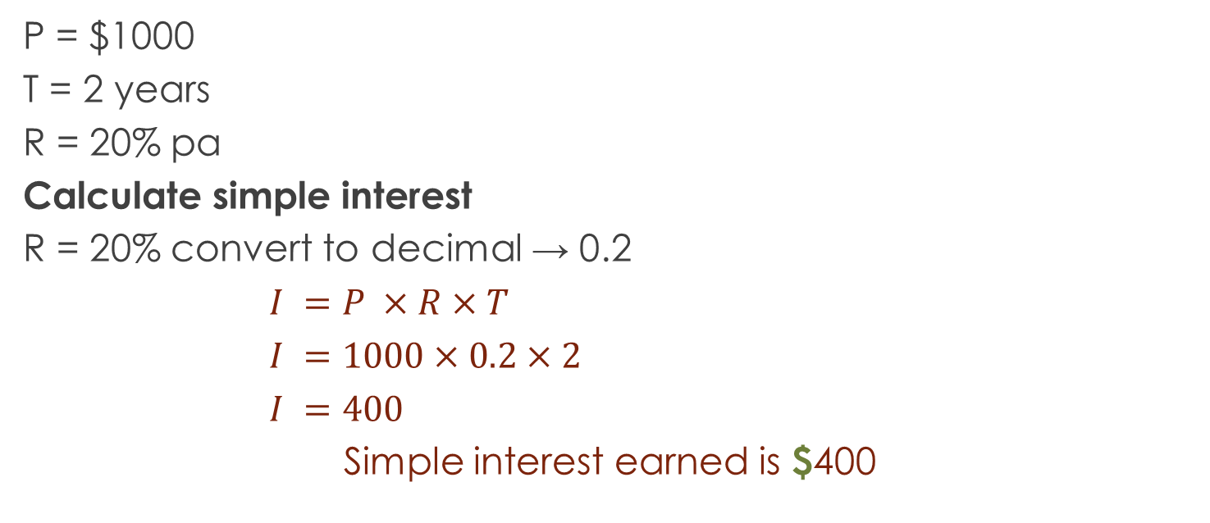
Let’s Try It Out
P = $1000
T = 2 years
R = 20% pa
Calculate simple interest
R = 20% convert to decimal → 0.2
$I =P ×R×T$
$I =1000×0.2×2$
$I =400$
Simple interest earned is $400
Now you try with a partner :
P = $1,500
T = 3 years
R= 15% p/a

Slide 7
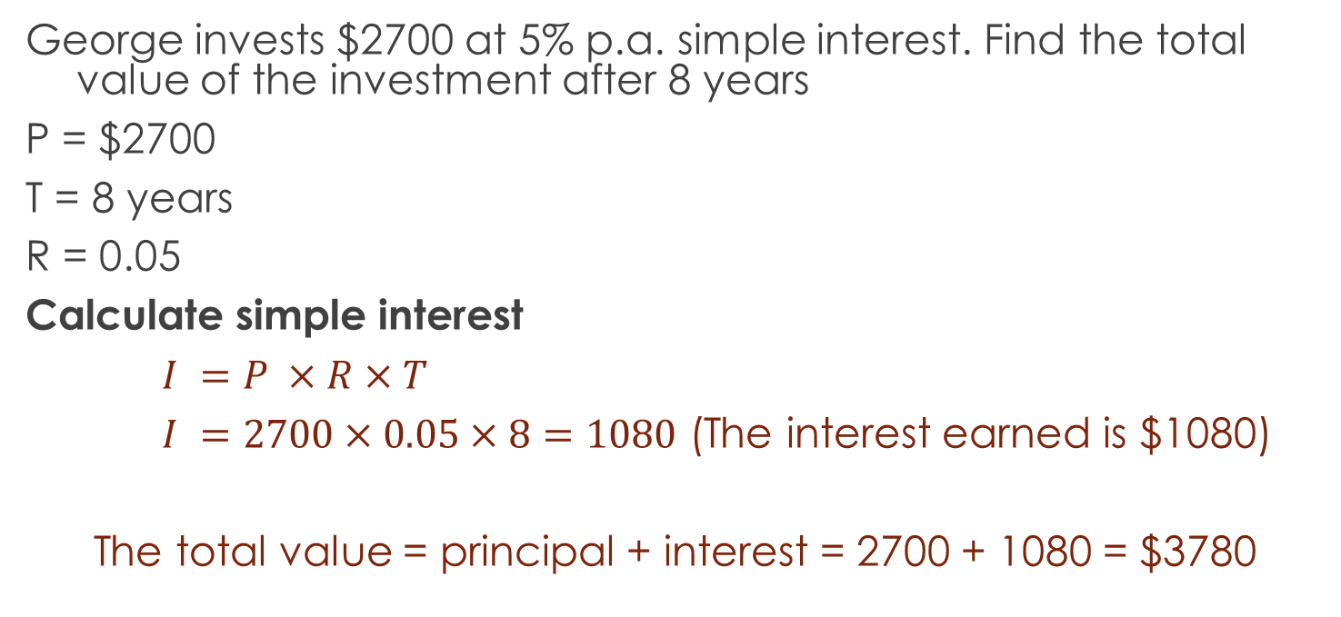
Let’s Try It Out
George invests $2700 at 5% p.a. simple interest. Find the total value of the investment after 8 years
P = $2700
T = 8 years
R = 0.05
Calculate simple interest
$I =P ×R×T$
$I =2700×0.05×8=1080$ (The interest earned is $1080)
The total value = principal + interest = 2700 + 1080 = $3780

Slide 8
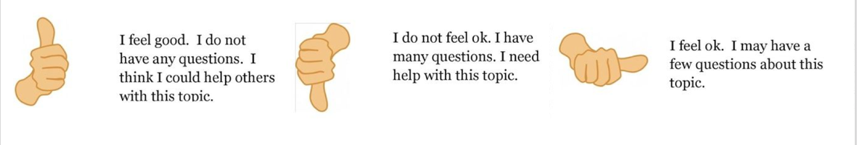
Check our understanding

Slide 9
One More To Be Sure
Ray has $750 in a savings account that pays 3% pa simple interest. How much interest will he earn in 4 years?

Slide 10
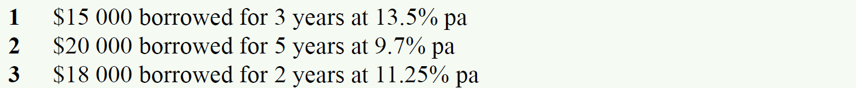
Calculate the Simple Interest

Slide 11
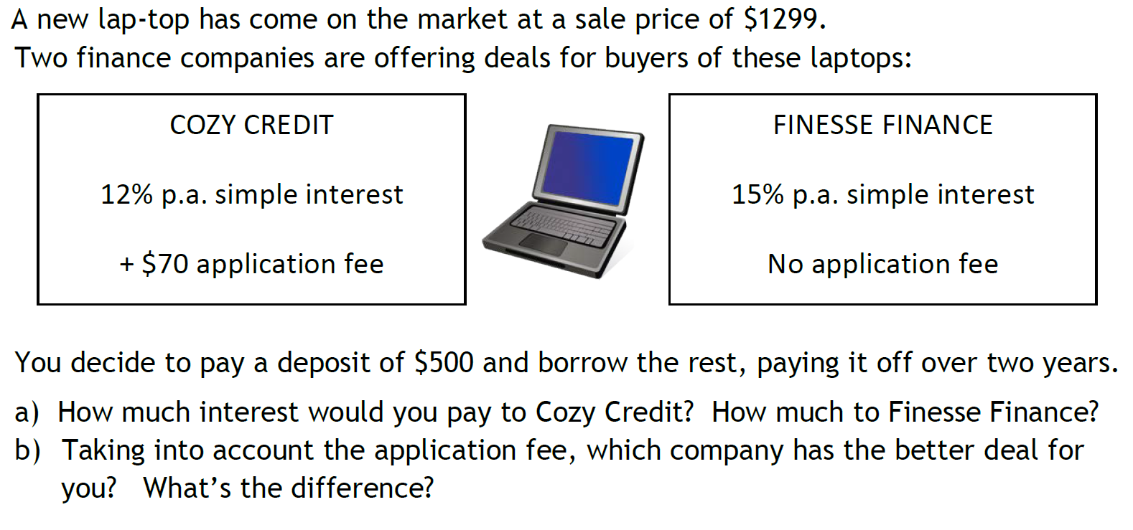
Task

Slide 12
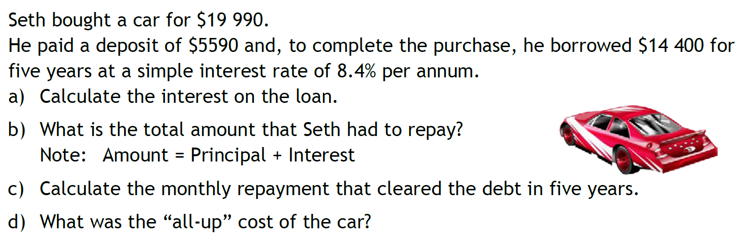
Task

Slide 13
HomeWORK
Complete your summaries
Add new terms to your glossaries
Write your questions
24, 7, 30

